Slide 1

Hard-label Black-box Universal Adversarial Patch Attack
Hard-label
Black-box
Universal
Guanhong Tao, Shengwei An, Siyuan Cheng, Guangyu Shen, Xiangyu Zhang

Slide 2
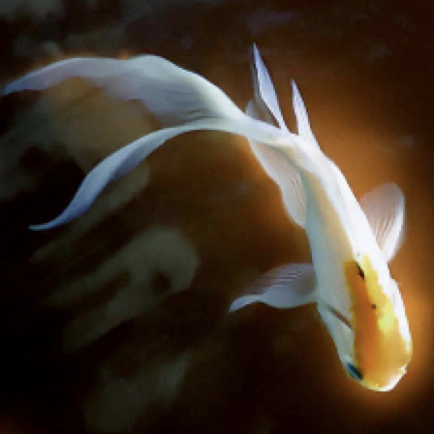
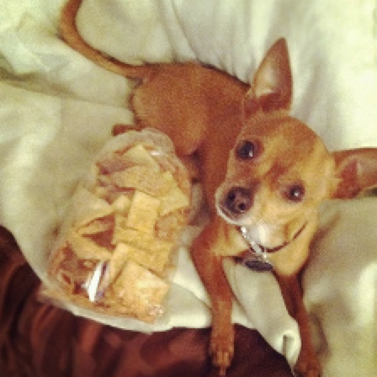

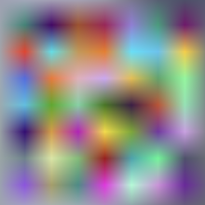

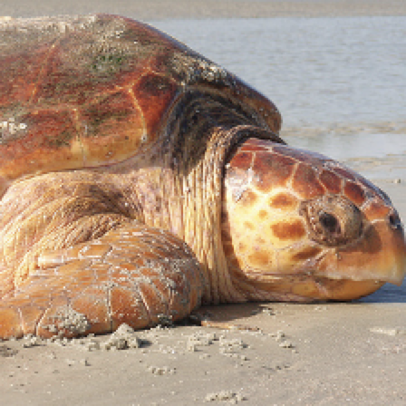
Confidence
0.03
Dog
0.1
Query
Fish
0.03
Output
0.91
Bird
0.9
Turtle
0.03
Universal
Induce misclassification for any given input
Black-box
No access to the model weight parameters
Hard-label
Only have the knowledge of the predicted label
Hard-label Black-box Universal Adversarial Patch Attack

Slide 3

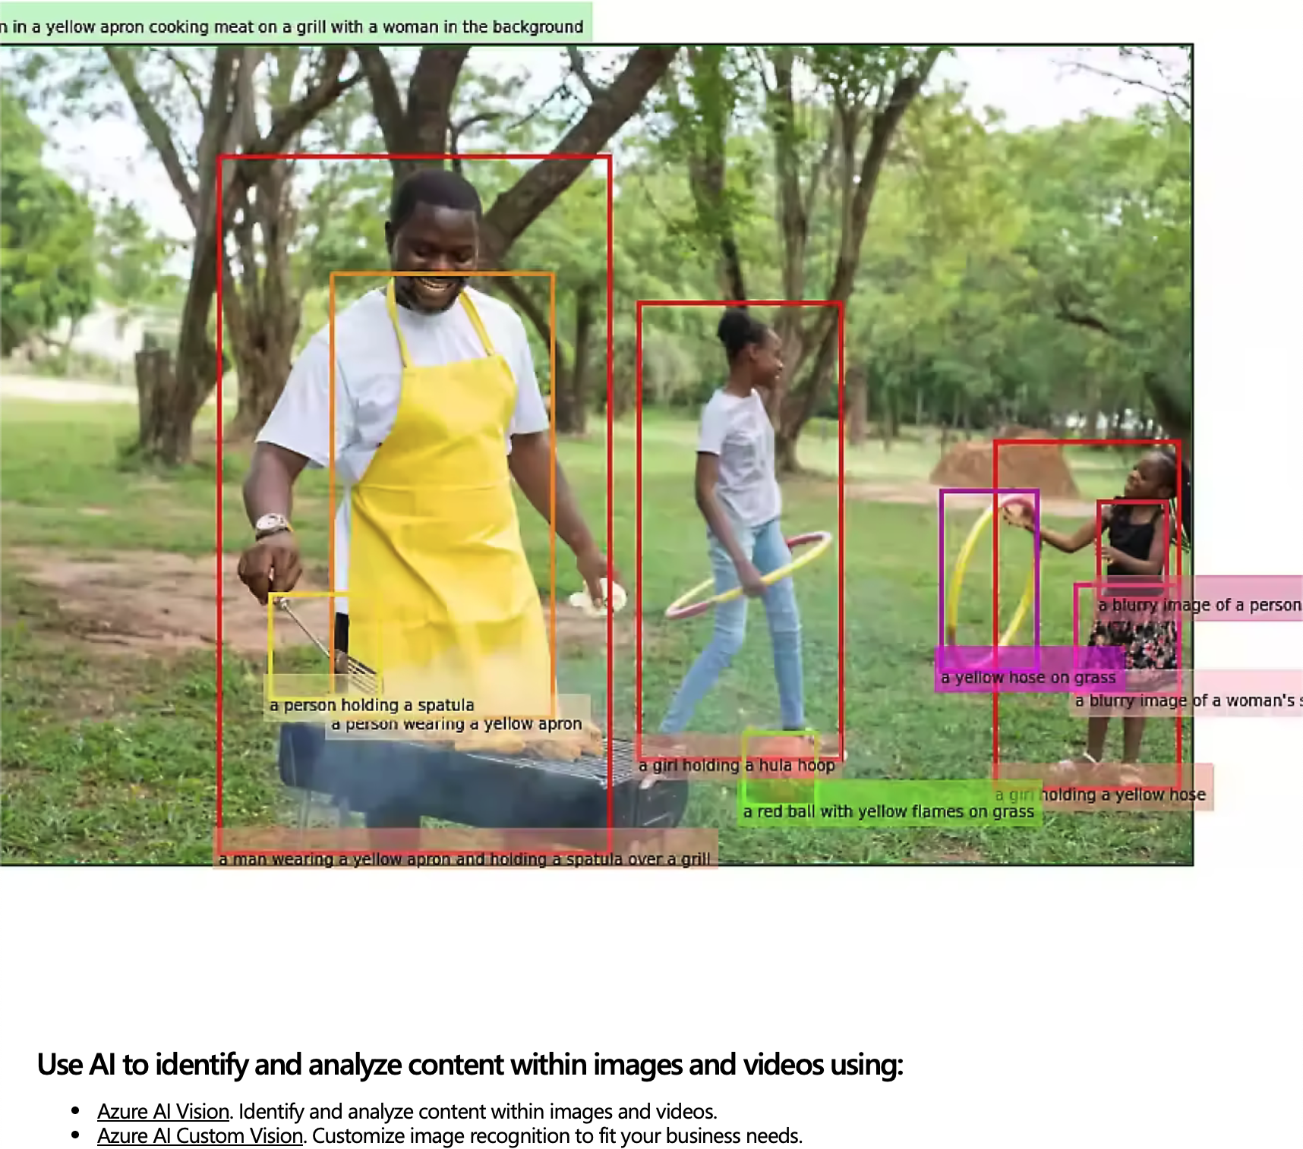
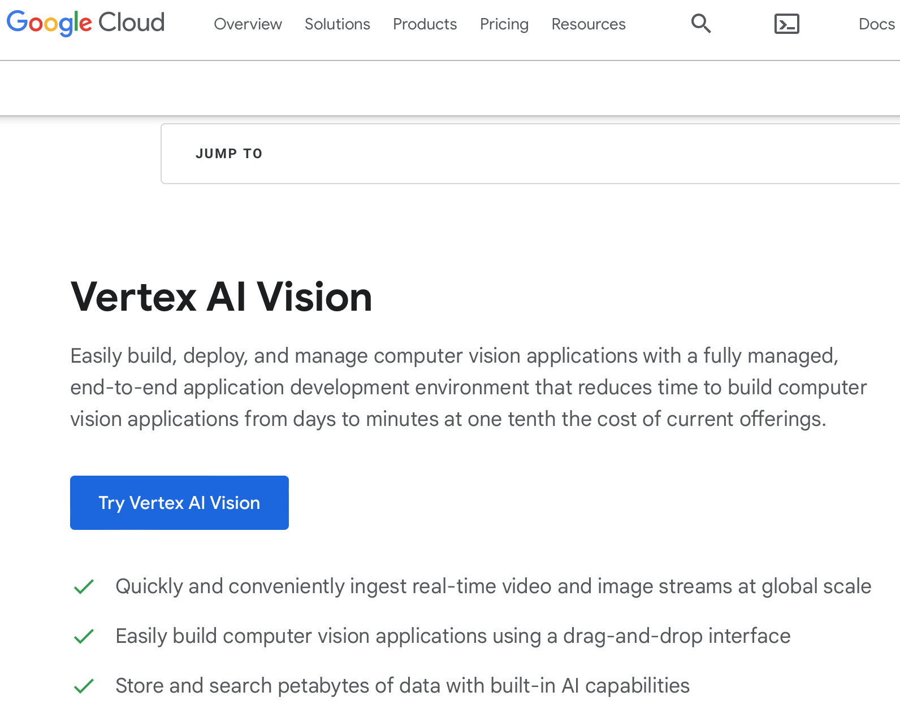
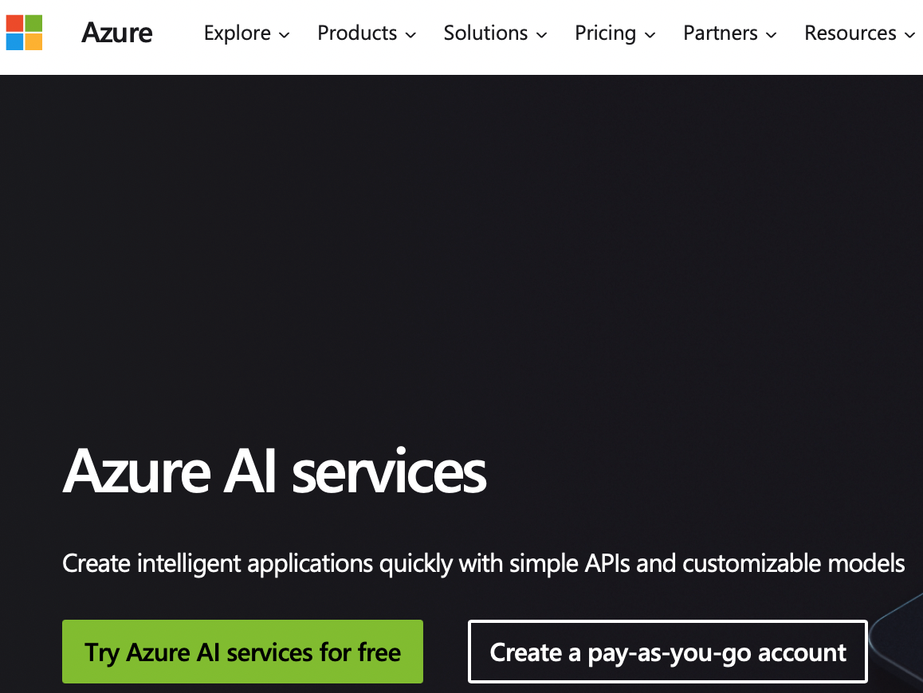
Why Hard-label Black-box Universal Attack?
Machine learning as a service (MLaaS)
Companies deploy ML models on online platforms
Applications using MLaaS are suspectable to attacks: facial recognition, optical character recognition, etc.
ML Models are intellectual properties
Only provide API access → black-box
Only return the predicted result → hard-label
Limited number of queries → universal
Hard-label Black-box Universal Adversarial Patch Attack

Slide 4

How To Generate?
Confidence
White-box
Dog
0.9
Black-box
Bird
0.1
Trigger
Input
Model
Gradient
∇ [
(
]
⊕
) = Bird
Hard-label Black-box Universal Adversarial Patch Attack

Slide 5

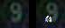

Let’s Approximate It!
Misclassified
Black-box
Bird
✓/✗?
Trigger + Noise
Input
Model
For a single input, add a set of random noises on the trigger
Inspect whether any noise leads to the target prediction
Obtain the (estimated) gradient based on the noises
Aggregate the gradients for multiple inputs to mutate the trigger
Hard-label Black-box Universal Adversarial Patch Attack

Slide 6
Gradient Estimation for Multiple Inputs
Leverage historical misclassified rate
Dynamically adjust importance
Direct Estimation
Importance-aware Estimation
Hard-label Black-box Universal Adversarial Patch Attack

Slide 7
Is Grad Approx. Sufficient?
Additive noises may not increase the attack success rate
Hard to determine the magnitude of the noise
Limited number of queries
History is always instructive!
Two close-by minima indicate a promising region
Interpolation between them yields a better trigger
Hard-label Black-box Universal Adversarial Patch Attack

Slide 8
Experiment Setup
Datasets & Models
Commercial Services
Baselines
Datasets: CIFAR-10, SVHN, STL-10, GTSRB
Models: ResNet18, ResNet34, ResNet50, VGG11, GoogleNet, DenseNet121, MobileNet V2
Microsoft Azure¹
Clarifai²
3 hard-label black-box adversarial attacks: HSJA³, GRAPHITE⁴, SparseEvo⁵
3 soft-label black-box attacks: Bandits⁶, SPSA⁷, Sparse-RS⁸
¹ https://azure.microsoft.com/en-us/ services/cognitive- services/
² https://www.clarifai.com/
³ Chen, Jianbo, et al. HopSkipJumpAttack: A query-efficient decision-based attack. S&P 2020.
⁴ Feng, Ryan, et al. Graphite: Generating automatic physical examples for machine-learning attacks on computer vision systems. EuroS&P 2022.
⁵ Vo, Viet, et al. Query efficient decision based sparse attacks against black-box deep learning models. ICLR 2022.
⁶ Ilyas, Andrew, et al. Prior convictions: Black-box adversarial attacks with bandits and priors. ICLR 2019.
⁷ James C Spall. A one-measurement form of simultaneous perturbation stochastic approximation. Automatica 1997.
⁸ Croce, Francesco, et al. Sparse-RS: a versatile framework for query-efficient sparse black-box adversarial attacks. AAAI 2022.
Hard-label Black-box Universal Adversarial Patch Attack

Slide 9
Attack Performance
Generate a trigger for each pair of classes
Size: 7x7 (4.79% of the input) # Queries: 50k
Count the number of pairs above a certain attack success rate (ASR)
Hard-label Black-box Universal Adversarial Patch Attack

Slide 10
Attacking Online Services
Two online commercial services: Microsoft Azure and Clarifai
Upload data for training (not deployed)
Use the prediction API for attack
Size: 7x7 # Queries: 240
Results (averaged on 10 pairs)
Azure: 74% (vs. 60% by HSJA)
Clarifai: 74% (vs. 53% by HSJA)
Hard-label Black-box Universal Adversarial Patch Attack

Slide 11
Countermeasures
Certifiable Defense: PatchCleanser¹
Produce correct predictions no matter whether inputs are adversarially perturbed
Average certified robust accuracy: 0.17%
Query-based Defense: Blacklight²
Identify malicious queries by black-box attacks
Average detection rate: 0.2%
Universal Adversarial Patch Detection: SentiNet³
Reject adversarially perturbed inputs
Average detection accuracy: 50.53%
¹ Xiang, Chong, et al. PatchCleanser: Certifiably robust defense against adversarial patches for any image classifier. USENIX Security 2022.
² Li, Huiying, et al. Blacklight: Scalable defense for neural networks against query-based black-box attacks. USENIX Security 2022.
³ Chou, Edward, et al. SentiNet: Detecting localized universal attack against deep learning systems. SPW 2020.
Hard-label Black-box Universal Adversarial Patch Attack

Slide 12
Related Work
[1] Chen, Jianbo, et al. HopSkipJumpAttack: A query-efficient decision-based attack. S&P 2020.
[2] Feng, Ryan, et al. Graphite: Generating automatic physical examples for machine-learning attacks on computer vision systems. EuroS&P 2022.
[3] Vo, Viet, et al. Query efficient decision based sparse attacks against black-box deep learning models. ICLR 2022.
[4] Ilyas, Andrew, et al. Prior convictions: Black-box adversarial attacks with bandits and priors. ICLR 2019.
[5] James C Spall. A one-measurement form of simultaneous perturbation stochastic approximation. Automatica 1997.
[6] Croce, Francesco, et al. Sparse-RS: a versatile framework for query-efficient sparse black-box adversarial attacks. AAAI 2022.
[7] Gilks, Walter R, et al. Markov chain Monte Carlo in practice. CRC press, 1995.
[8] Banzhaf, Wolfgang, et al. Genetic programming: an introduction: on the automatic evolution of computer programs and its applications. Morgan Kaufmann Publishers Inc., 1998.
[9] Xiang, Chong, et al. PatchCleanser: Certifiably robust defense against adversarial patches for any image classifier. USENIX Security 2022.
[10] Li, Huiying, et al. Blacklight: Scalable defense for neural networks against query-based black-box attacks. USENIX Security 2022.
[11] Chou, Edward, et al. SentiNet: Detecting localized universal attack against deep learning systems. SPW 2020.
...
Hard-label Black-box Universal Adversarial Patch Attack

Slide 13
Conclusion
Propose a novel hard-label black-box universal adversarial patch attack, obtaining more than twice high-ASR patch triggers (>90%) than eight baselines
Successfully attack two online commercial services, Microsoft Azure and Clarifai, with an average ASR of 74%
Effectively evade three state-of-the-art defense techniques
Hard-label Black-box Universal Adversarial Patch Attack

Slide 14
Thank You
Guanhong Tao
taog@purdue.edu
https://www.cs.purdue.edu/homes/taog/

